Slide 1
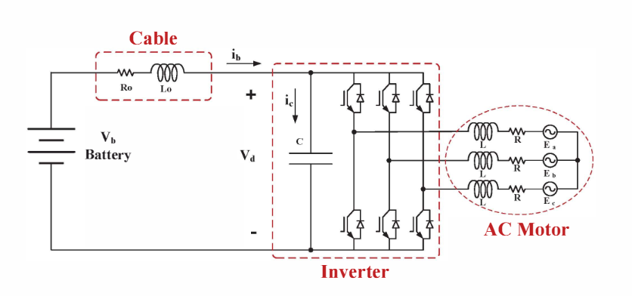
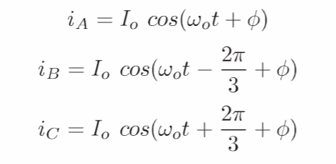
Basic Inverter Model
Combined Inverter and battery model
Do not consider output harmonics

Slide 2
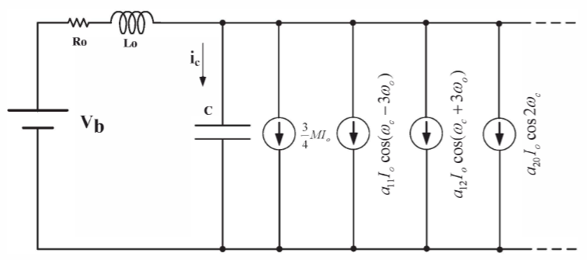
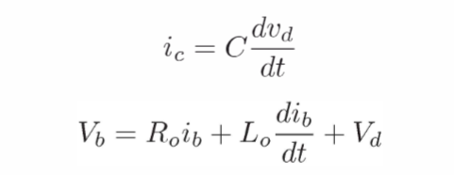

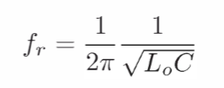
Harmonic Model
EMI
DC Bus current can be modelled by harmonics.
The spectrum of the battery current shows that in addition to the dc component, there would a component resonance between the cable and dc bus capacitor.

Slide 3
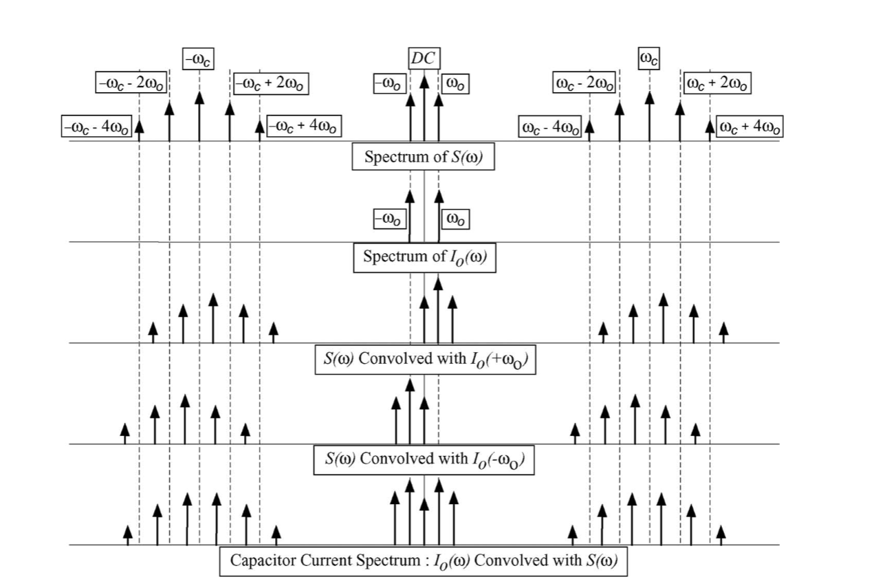
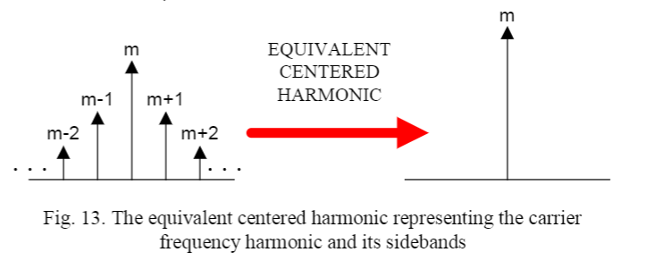
Switching Functions and Convolution

Slide 4
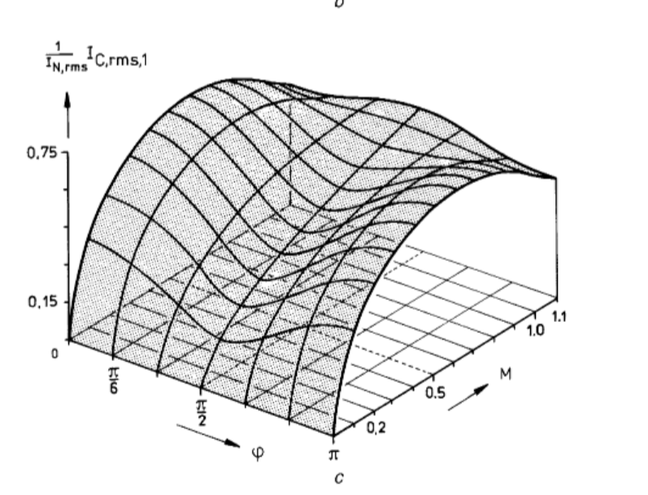
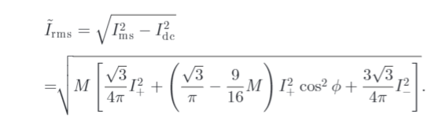
RMS Model
Assume all high-frequency ripples go to the DC-link capacitor

Slide 5
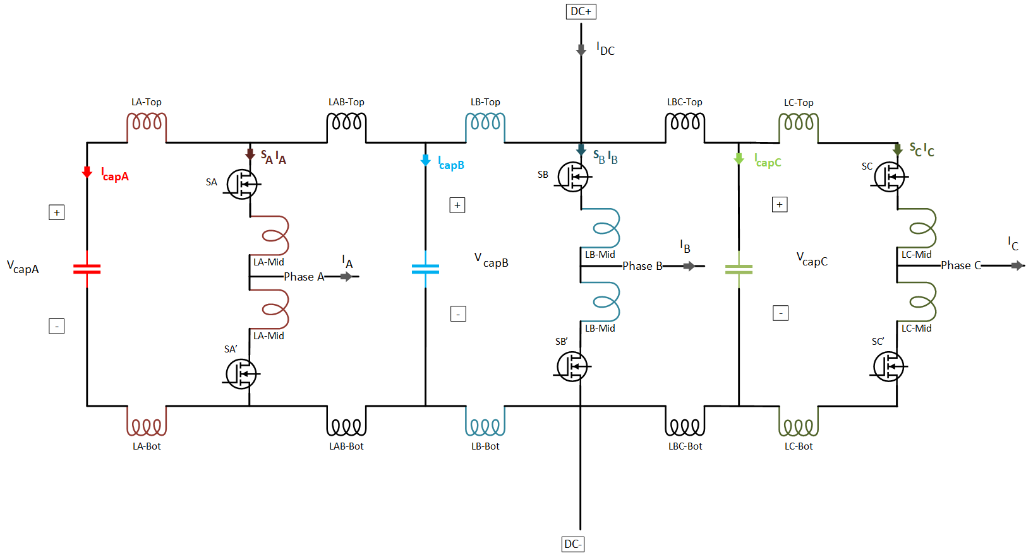

Realistic Model
Measurements:
Capacitor currents ($I_{capA}$, $I_{capB}$, $I_{capC}$)
Capacitor voltages ($V_{capA}$, $V_{capB}$, $V_{capC}$)
Leg Currents ($S_{A}I_{A}$, $S_{B}I_{B}$, $S_{C}I_{C}$)
Phase Currents ($I_{A}$, $I_{B}$, $I_{C}$)
DC input ($V_{DC}$, $I_{DC}$)

Slide 6
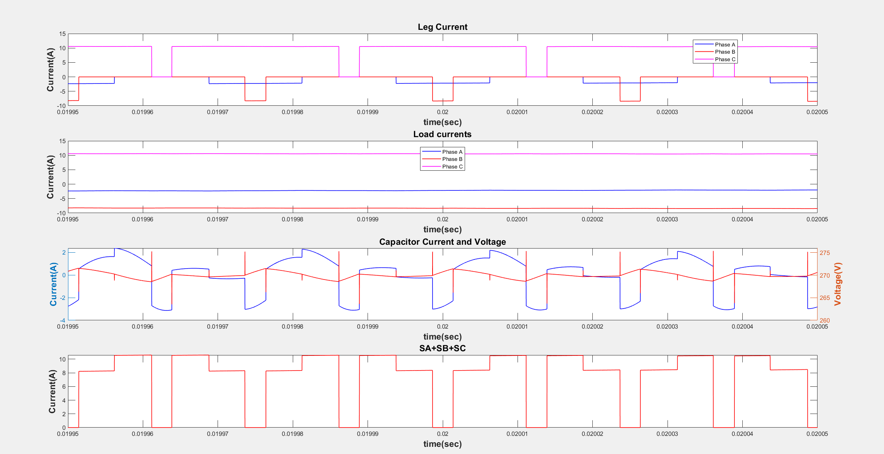
Effect of Stray Inductance

Slide 7
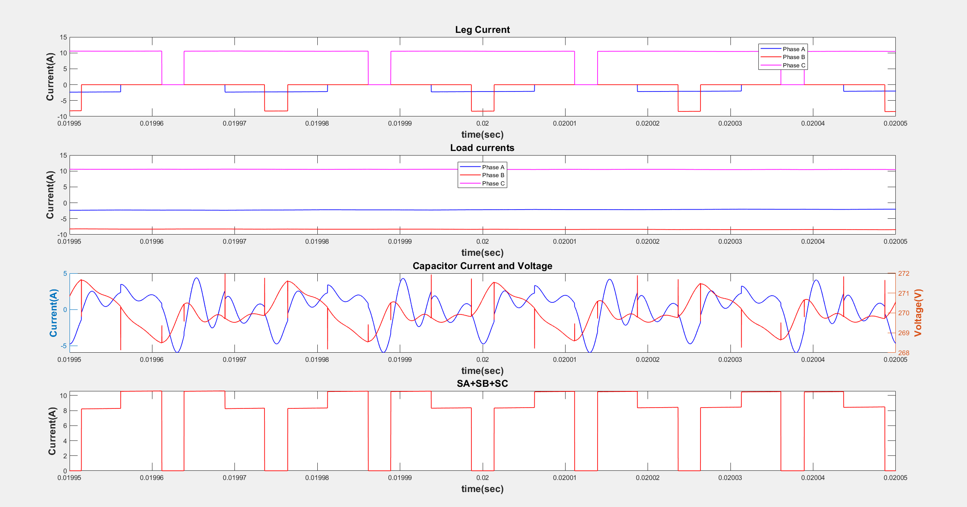
Effect of Stray Inductance

Slide 8
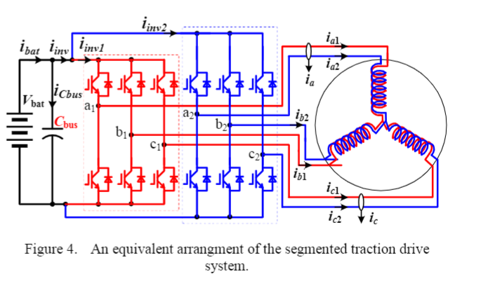
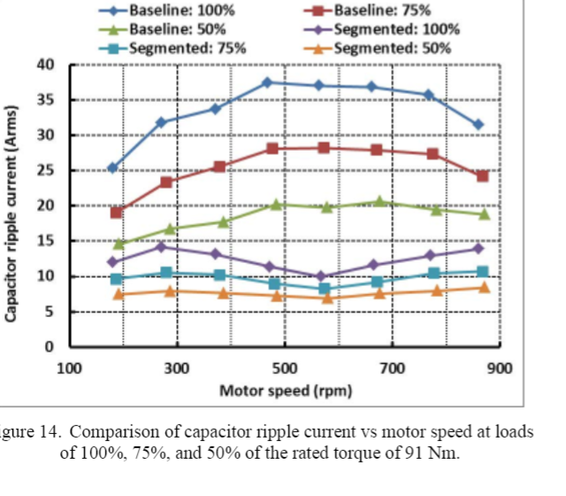
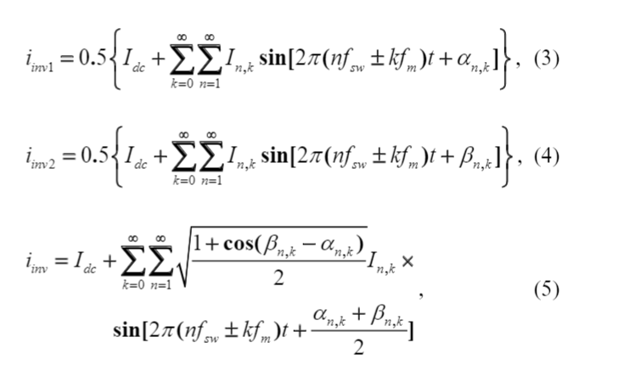
Segmented Traction Drives
Interleaving

